Slide 1
Further topics & closure
Slides CC BY-SA

Slide 2
Final topics
Projects & folder structure – starting from blank slate
Publishing with R – Hugo Academic, blogdown, papaja
Version control – git & Github
Learning resources
Notes:
But the most important people you will be working with today are seated right beside you

Slide 3








knitr
pandoc
Rmd
md
ioslides
slidy, Beamer
Powerpoint
Microsoft Word
3
CC BY-SA RStudio
Notes:
Used Rmarkdown throughout – but it can be used for much more than keeping track of statistical analyses

Slide 4
Markdown Logistics
Knitr runs the document in a fresh R session, which means you need to load the libraries that the document uses in the document
1
CC BY-SA RStudio

Slide 5
Markdown Logistics
Knitr runs the document in a fresh R session, which means you need to load the libraries that the document uses in the document
1
Objects made in one code chunk will be available to code in later code chunks.
2
CC BY-SA RStudio

Slide 6
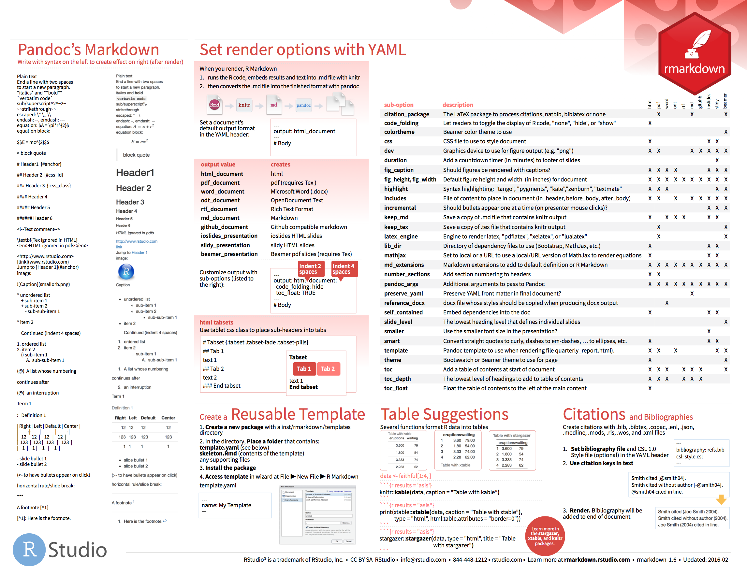

Markdown
Dictionary of formatting cues.
on back of RMarkdown cheat sheet
6

Slide 7
Inline code
Code whose results are inserted into the text.
Today is `r Sys.Date()`.
Surround with `r `
Code to run. Only the result will be included.
7
CC BY-SA RStudio

Slide 8
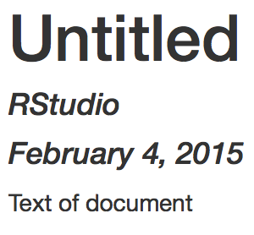
YAML Header
A section of key:value pairs separated by dashed lines ———
---
title: "Untitled"
author: "RStudio"
date: "February 4, 2015"
output: html_document
---
Text of document
CC BY-SA RStudio

Slide 9
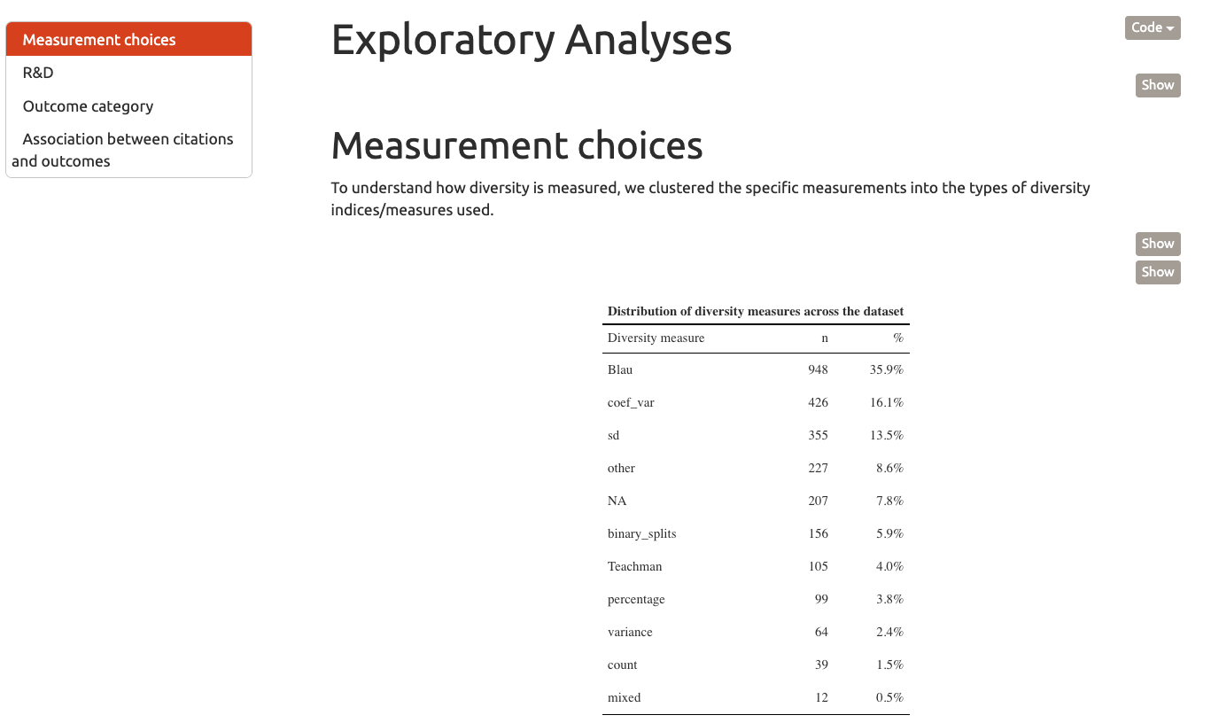
Helpful formatting defaults
---
title: "Untitled"
output:
html_document:
toc: yes
toc_float: true
code_folding: hide
---
Text of document
CC BY-SA RStudio

Slide 10
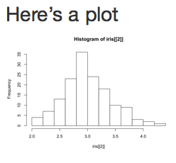
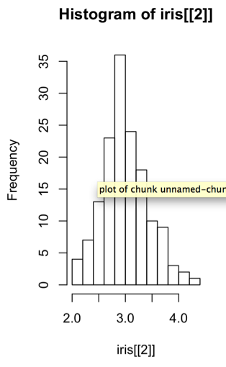
Chunk options:
fig.height, fig.width
Specify the dimension of plots (in inches) with fig.width and fig.height. Separate multiple arguments with commas.
Here’s a plot
```{r echo=FALSE, fig.width=3, fig.height=5}
hist(iris[[2]])
```
10
CC BY-SA RStudio
Notes:
A learner persona is a detailed profile of a representative, but perhaps imaginary student.
The technique borrowed from UI designers.
Lesson design is all about putting yourself in your learner's shoes, and this is a helpful way to do that. It is all you will have to go on until you can start to get student/day of class feedback. A good learner persona should consist of five parts.
Here's an example persona written by Greg: "Jean is a professor of Computer Science whose research area is operating systems. She has been teaching undergraduate classes for six years, and increasingly believes there has to be a better way. The only training available through her university's teaching and learning center relates to posting assignments and grades in the learning management system, so she wants to find out what else she ought to be asking for."

Slide 11
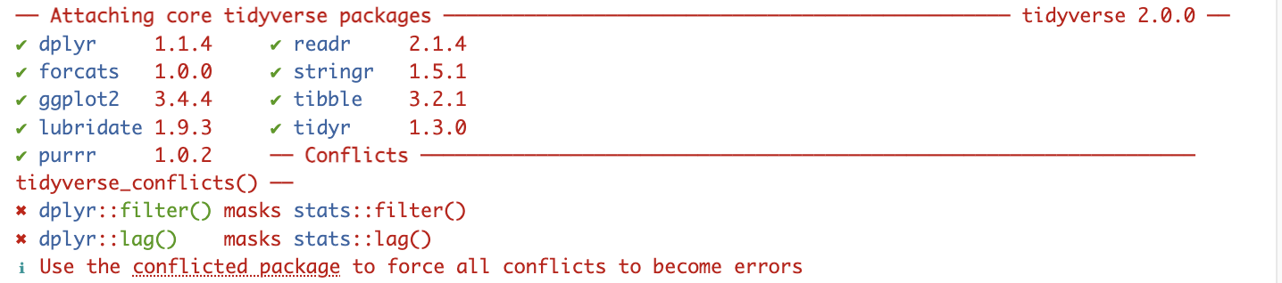

Chunk options:
messages
Quieten the tidyverse
```{r setup, messages=FALSE}
library(tidyverse)
```
11
CC BY-SA RStudio

Slide 12
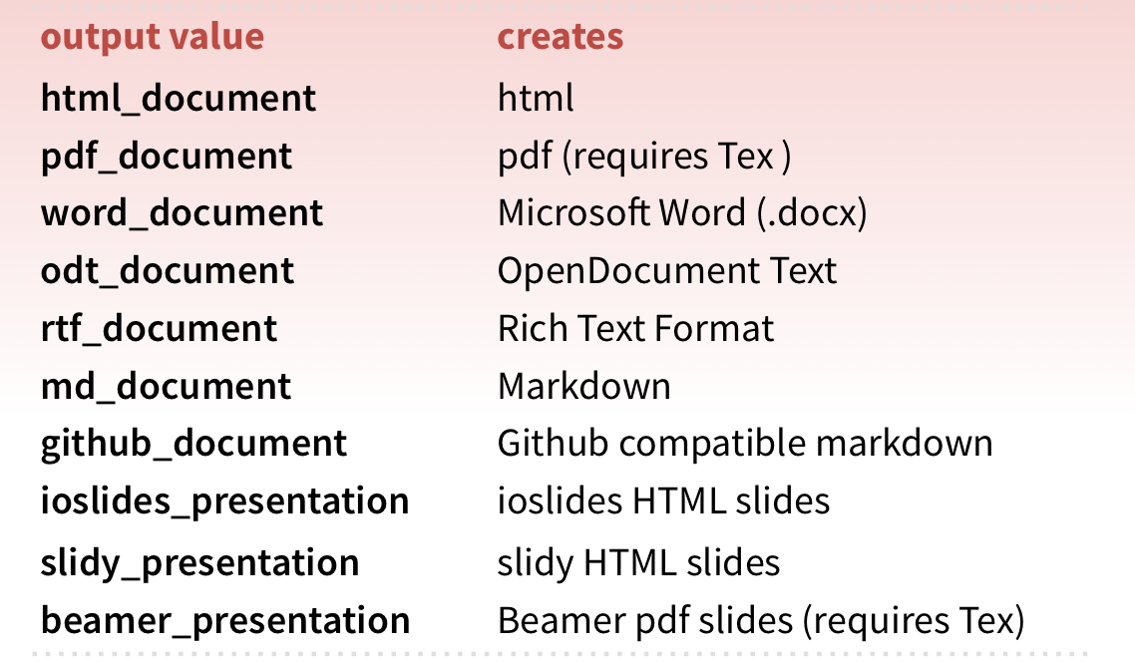
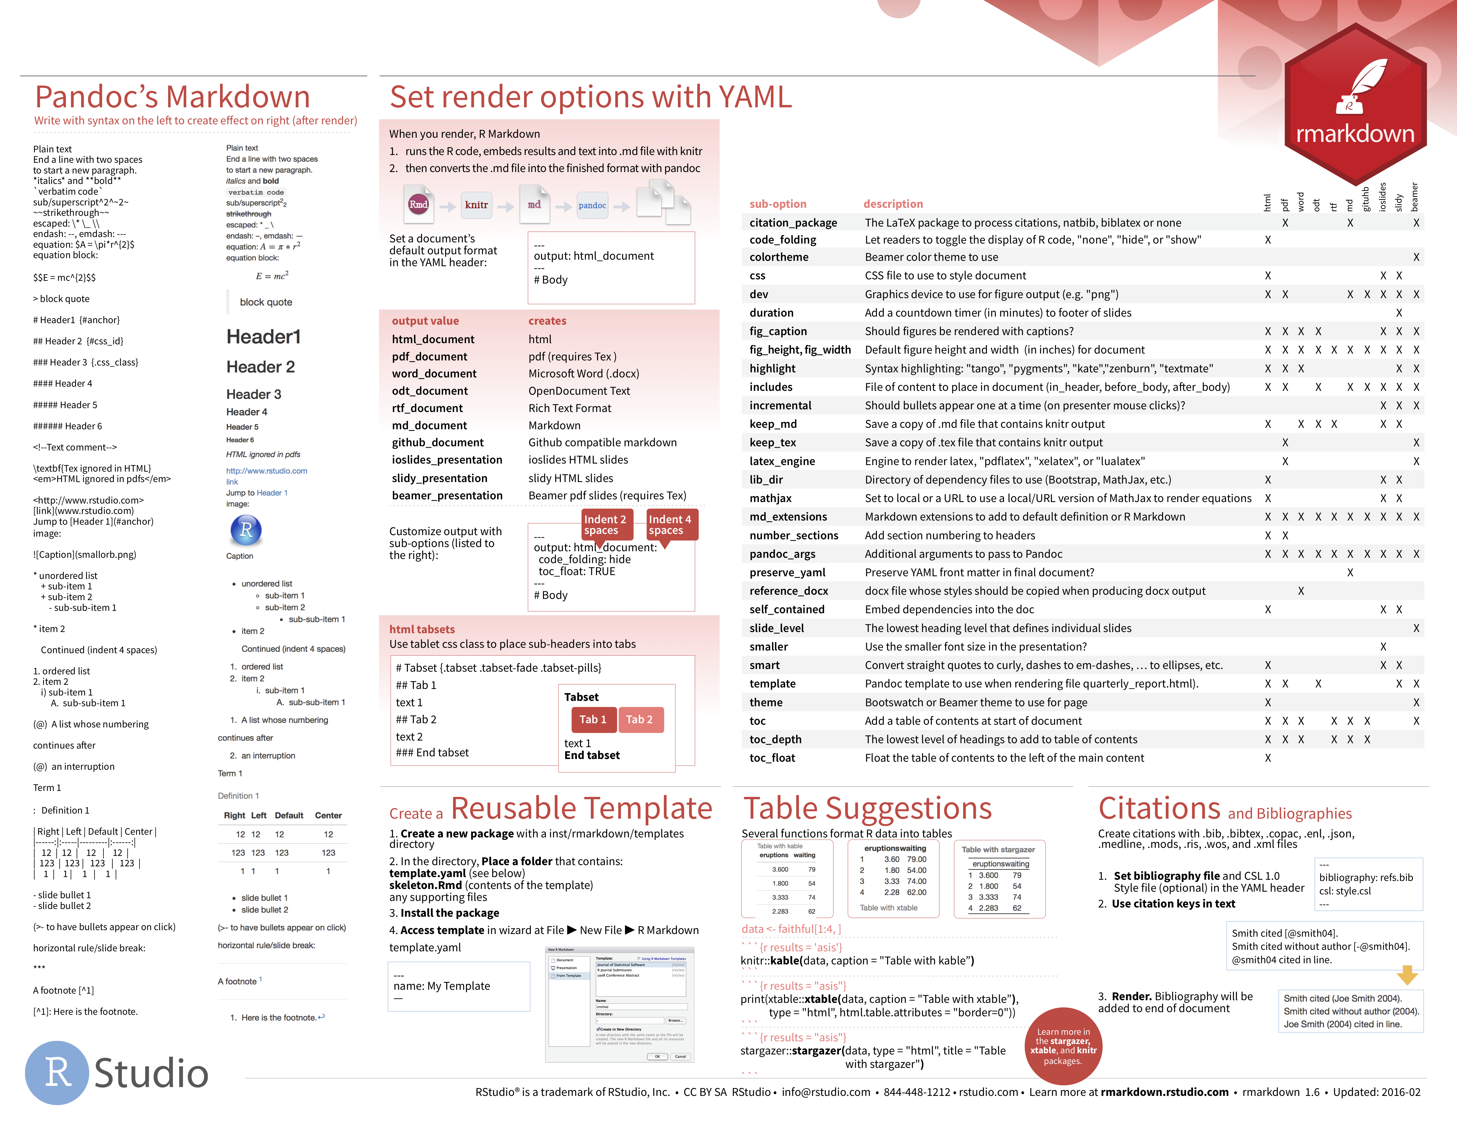
output
The output: field sets the format of the final report
on back
More at rmarkdown.rstudio.com/formats.html
CC BY-SA RStudio

Slide 13
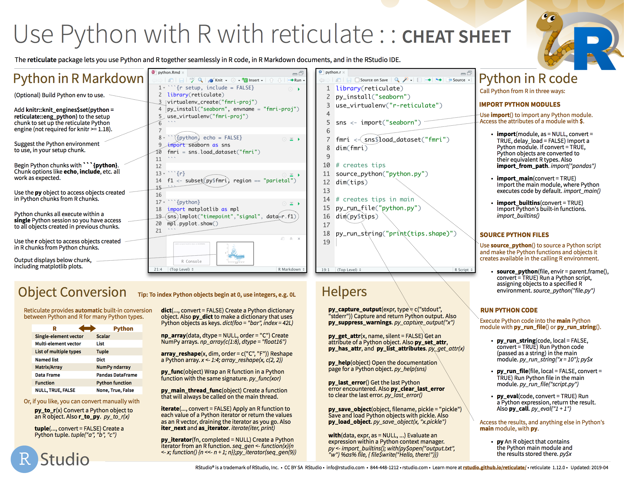
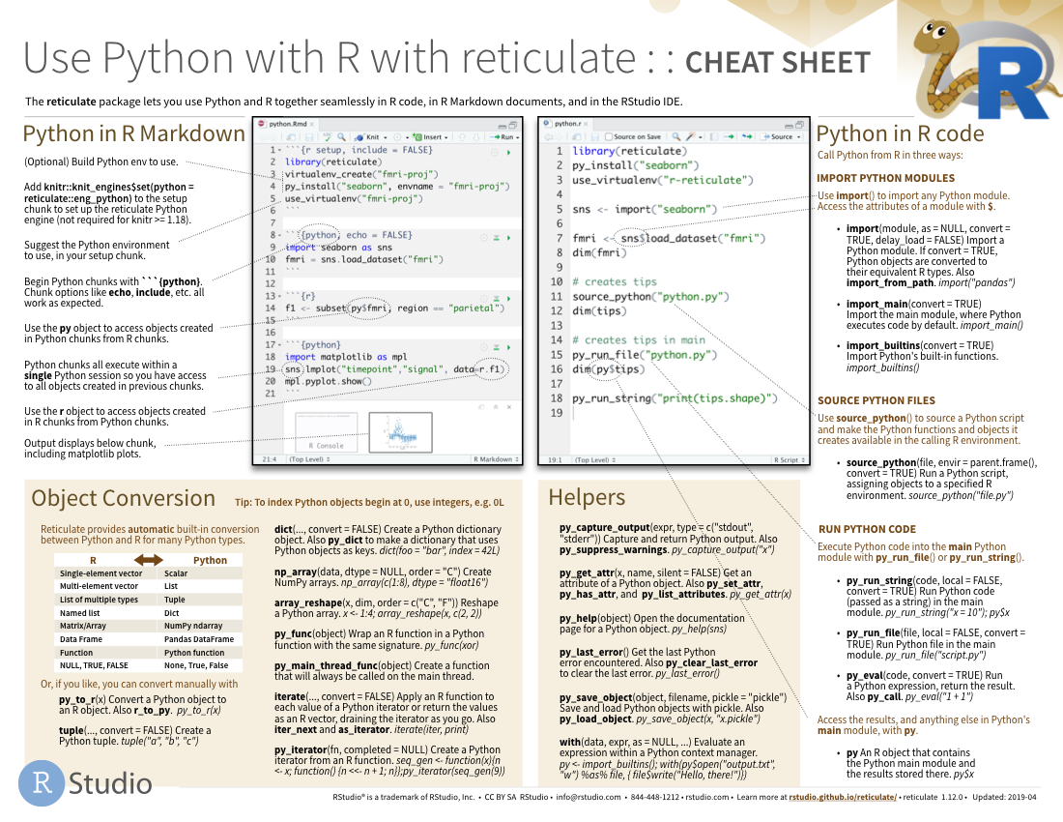
Reticulate
A package for using R and Python together.
13

Slide 14
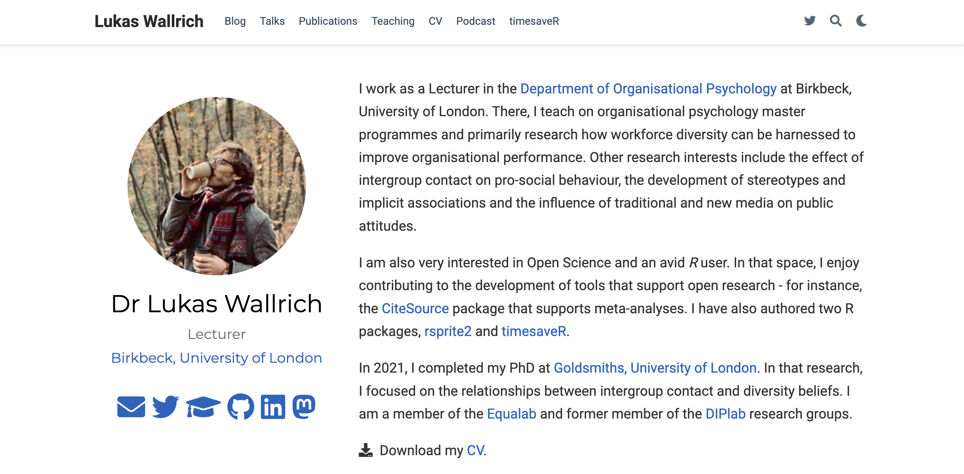


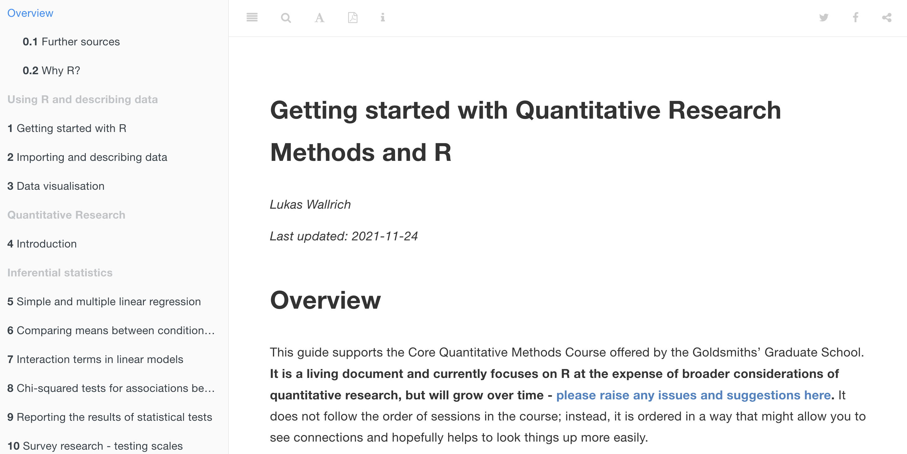

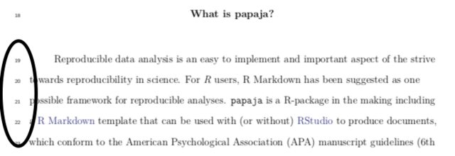
Publishing with R

Slide 15
Using GitHub
Find code
Report bugs
Contribute to packages
Share materials (e.g., supplementary)
Backup your code
Collaborate

Slide 16
Using git
Your personal time machine, backup, breadcrumb trail, and collaboration guide

Slide 17
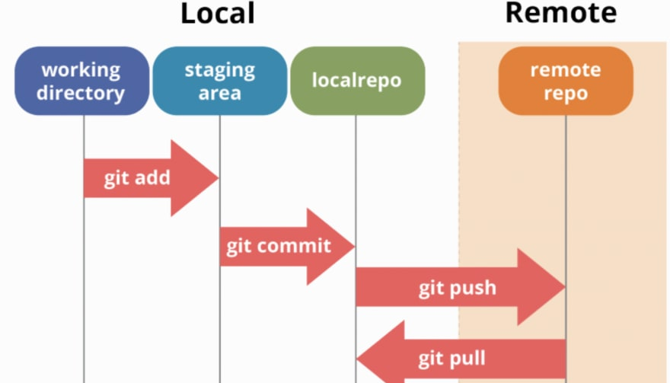
Using git
Check https://happygitwithr.com/
Notes:
https://dev.to/mollynem/git-github--workflow-fundamentals-5496

Slide 18
Further learning
Datacamp.com
RStudio tutorials
Tidy Tuesday
Links from my course notes:
https://lukaswallrich.github.io/ GoldCoreQuants/

Slide 19


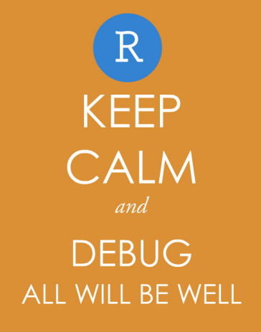
Coding: Stackoverflow
Stats:
CrossValidated
Minimum reproducible examples (reprex) – simple data, simple model, …
Report unexpected behaviour on GitHub Issues
Restart R … and your brain
Ask ChatGPT – then test answers

Slide 20


Slide 21

Congratulations &
Thank you!

